Slide 1


Team Leadership
Workshop
Uladzimir Litvinau
August 2024
Notes:
If there is no objections, I’ll switch on recording of the session
Thank you for making the time to attend this session
Goals – define who is teamlead, what is team and what are the main teamlead responsibilities and work areas.
How to build and lead a team.

Slide 2
(Recording) Table of Contents
01
Speaker
07
Couple of useful theories
02
Rules
08
Use-Cases
03
How to learn?
09
Homework
04
TL: Responsibilities
10
Q&A
05
TL: Definitions
06
Team development model
Notes:
So just to run you through what I'd like to cover today (take normal temp, don’t start to speed upping the speech)
Speaker – this is the most important part
Rules – how we’ll work TOGETHER today
How to learn? – if you don’t know, or even if you think that you know – it will be helpful to remind it
Use cases – our main activity for today, we’ll play a virtual team leading path with new team – from it’s start, till the end, and we’ll try to find a solutions for a different situations and problems

Slide 3
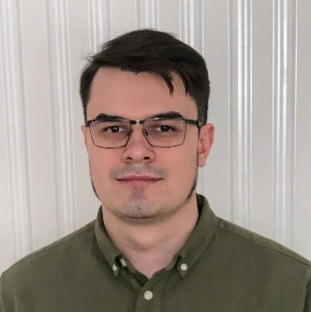
Speaker: Uladzimir Litvinau Software Engineering Team Leader
01
Experience:
Head of Java Department in xxx company (150+)
BE Guild Lead on WALG-CORE project in EPAM (600+)
Primary Skills:
Java (13 years)
Leading (10+ years)
Notes:
I’m truly leading enjoyer, my area of interest is to be able to build production from scratch both from a technological point of view and from the point of view of people.
On WALG-CORE project I’ve been executing many roles – team lead, NFR stream lead, and the most important is BE Guild lead – you can say that it was team lead of team leads role. My main task were to help to build an agile teams, and to build a big distributed team from those agile teams and their leads.
Very interesting, very challenging job – and regarding feedbacks I was able to do it.
With growing responsibilities.

Slide 4
Work hard now Save hundreds of hours and nerves in future…
Every team lead should start from:
Initial Rules
No multitasking – 2 hour of concentration
Switching on your cameras will be very nice
This knowledge will be useful and for leads and for team members
10 years of experience key lessons learned
Be active (teamlead should have and be able to express his opinion, to start a search of solution)
Back to school
Formulate your statements correctly - do not forget about the characteristic of measure (sometimes, always, never, from my experience and etc)
Notes:
Processes and known rules
Even if you think that you have nothing to say, from my practice, you actually do, and it could be very interesting and unusual vision of situation
Listen to a different opinions and to extracting the knowledge from them – this is one of our goals for today.
If you'd like me to elaborate on any poing please ask
Ask to raise hands those who are ready to work today
By the end of my talk you'll have a clear plan of how to build a team and how to act if different situations.

Slide 5

From Senior Developer to Junior Team Lead (and sometimes back)
Why we need to learn how to lead
Evolution
Team Lead
Developer
Notes:
It’s ok to try and to understand that it’s not yours – I’ll say more, it anyway will be a very valuable experience, that will help you to work as a developer too.

Slide 6


What is the difference in learning style of child and an adult?…
On current session, As a Lead, As A Team member
How to learn and how to teach?
VS
Notes:
Why are we talking about it? Because I need to teach you today, you need to learn today, and as a leads you’ll need to teach your team all the time during your work – that’s why!
Authority – java script is just an improved java, child will just take my point of view, but an adult has his own experience, and such approach won’t work.
Children
Adults – 90% is self education
1. Rely on others to decide what’s to be learned.
1. Decide for themselves what they want to learn.
Not always or necessarily. It depends on what children: age, gender, socio-economic and cultural background, teaching and learning experience at home, in school, etc.
Not always. It depends on what adults: age, gender, socio-economic and cultural background, educational level, etc.
2. Accept information at face value.
2. Question information, need to validate.
Not necessarily. Same as 1.
Not necessarily. Same as 1.
3. Expect learned information to be useful in the future.
Expect information to be useful now.
Not necessarily.
Many children (i.e. older children, the poor) would expect to learn something that they see useful and relevant now.
Are clean slates with little or no experience.
Are full slates with lots of experience.
Children are never clean slates. They have knowledge and experience no matter their age.
No one is ever a full slate. Adult learners may have no experience (knowledge and skills) in some specific areas.
Have limited ability to be a resources to classmates.
Significant ability to serve as resource to others.
Children have great abilities to help others, not only peers but also young people and adults.
Are content-centered.
Are process or problem-centered.
If given the chance, they also enjoy problem-solving and are interested in understanding the methodology and the process.
Many adults are also keen on information and content. It also depends on the content taught.
Are passively involved in learning.
Are actively involved in learning.
Because the school system often sets such rules. Children prefer to engage actively in learning.
Not necessarily, not always. Very often adults are also passive learners, conditioned by conventional education and training practices in and out of the school system.
Learning requires active involvement.
Learn best in an authoritative environment.
Learn best in a collaborative environment.
Not generalizable.
Not generalizable.
If given the chance, children enjoy learning in flexible, non-fear environments.
Many adult learners prefer more structured, authoritative environments.
Are motivated by external rewards: grades, advancement, avoidance of punishment.
Are motivated internally: self-esteem, curiosity, love of learning, self-improvement.
Children may be also internally motivated - the best way to learn.
Adults are often also externally motivated. (Teacher training is often a typical example of institutionalized externally motivated learning).

Slide 7
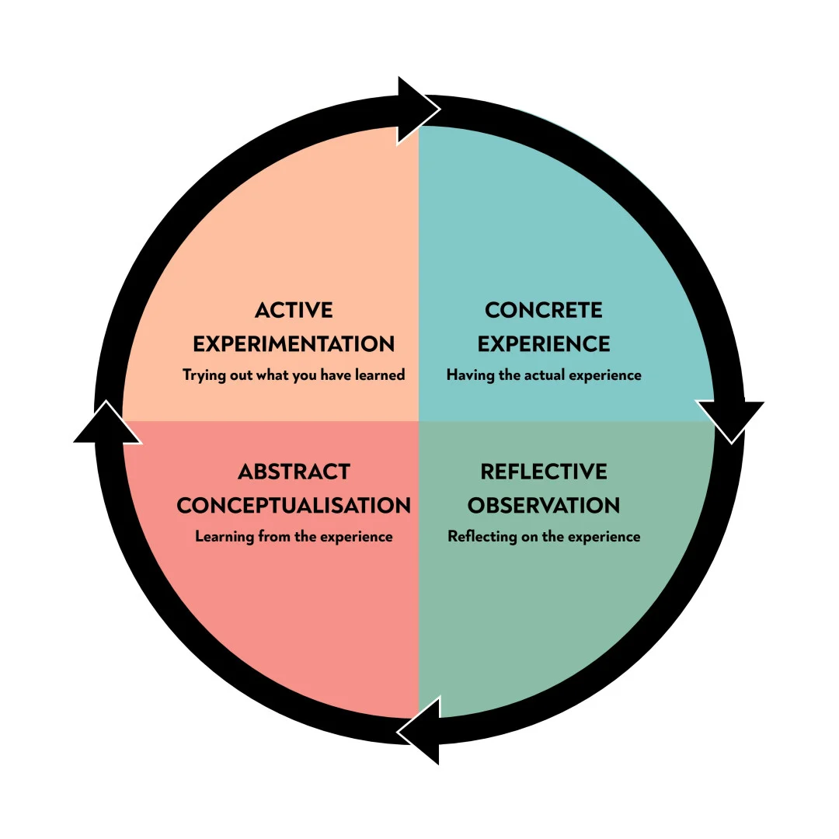
Kolb's Experiential Learning Theory
How to learn and how to teach
Kolb’s experiential learning style theory is typically represented by a four-stage learning cycle in which the learner “touches all the bases”
Concrete Experience – the learner encounters a concrete experience. This might be a new experience or situation, or a reinterpretation of existing experience in the light of new concepts.
Reflective Observation of the New Experience – the learner reflects on the new experience in the light of their existing knowledge. Of particular importance are any inconsistencies between experience and understanding.
Abstract Conceptualization – reflection gives rise to a new idea, or a modification of an existing abstract concept (the person has learned from their experience).
Active Experimentation – the newly created or modified concepts give rise to experimentation. The learner applies their idea(s) to the world around them to see what happens.
Notes:
It’s foundation for learning styles
All of you already have some experience and open cases, that’s why I can do a short overview of some theory that will be helpful for our use cases, but the main learning part will be when you’ll work on your homework after working on use cases today, and learning theory a more deep by your own

Slide 8

What are the key skills of a Team Lead? What is the difference between a group and a team?
Tricky question
Before the discussion

Slide 9
A team is a small number of people with complementary skills who are committed to a common purpose, set of performance goals, and approach for which they hold themselves mutually accountable.
Key definition
Definition of Team
Notes:
The Discipline of Teams (hbr.org)
You have responsibility among team
Name what things make team – team, not just a group of random people

Slide 10
What are the key skills of Team Lead?
Tricky question
Let’s try to find out now
Notes:
The 8 Key Leadership Skills You need to know in 2023 (imd.org)

Slide 11




Key Skills and Roles
Team Lead
Basic skills | Personal skills | Roles and responsibilities | Key activities
Read (how to read) Listen Analyze and synthesize (formal logic) Discuss (art of discussion) Learn Teach Solve Lead | Relationship building Agility and adaptability Innovation and creativity Employee motivation Decision-making Conflict management Negotiation Critical Thinking | Administrator Integrator People manager Product owner Technical lead | Team development Estimation Delegation Leading agile practices Feedback activities (SBI) Knowledge sharing Facilitation Teaching
Notes:
The 8 Key Leadership Skills You need to know in 2023 (imd.org)

Slide 12
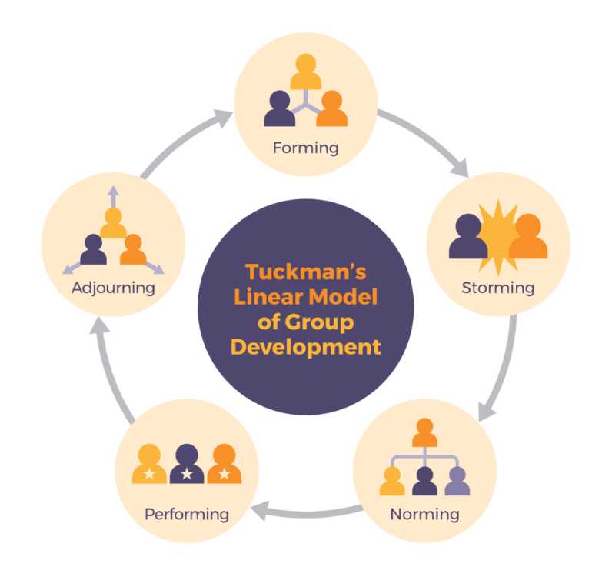
Team development model by Tackman
Your Main Activity
How to build a Team?
Notes:
Message from FreshBooks
Tuckman's Stages of Group Development - WCU of PA (wcupa.edu)
Maybe add more slides for each step for takeaways
Team development stageLeadership strategies
Keys to successForming (setting the stage)^{[12]}Coordinating behaviors– Purposefully picking the team– Facilitating team to identify goals
– Ensuring the team development of a shared mental model
Storming (resolving conflict and tension)^{[12]}Coaching behaviors– Act as a resource person to the team– Develop mutual trust –focus on rational, not emotional discussons –no teambildungs
– Calm the work environment
Norming and performing (successfully implementing and sustaining projects)^{[12]}Empowering behaviors– Get feedback from staff– Allow for the transfer of leadership
– Set aside time for planning and engaging the team
Outperforming and adjourning (expanding initiative and integrating new members)^{[12]}Supporting behaviors– Allow for flexibility in team roles– Assist in the timing and selection of new member
– Create future leadership opportunities –make sure that team members are ready for a new challenges and working in new teams

Slide 13
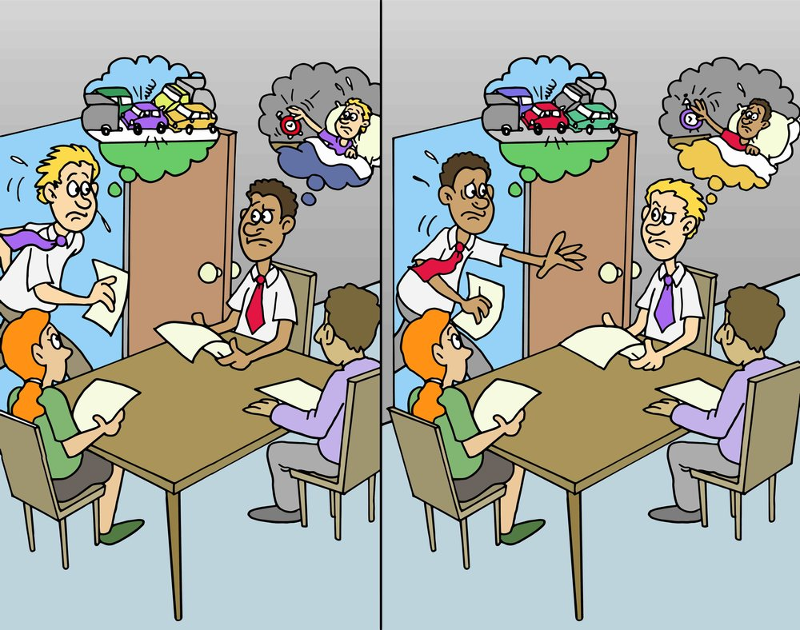
THE FUNDAMENTAL ATTRIBUTION ERROR
Point of view problem
The fundamental attribution error describes a common cognitive bias where individuals are inclined to ascribe the behavior of others to inherent personality traits, while attributing their own actions to environmental or situational influences.
In practical terms, this means that when it comes to evaluating others, we may overlook external factors and disproportionately blame their character. Conversely, we often excuse our own actions by citing circumstantial challenges or pressures.
Areas: Performance Review, Conflicts Resolution, Feedback (Internal and External)
Notes:
Fundamental Attribution Error: What It Is & How to Avoid It (hbs.edu)
I think that I’m late because of traffic, my colleague thinks that happen because I’m not a disciplined person, and it works some in opposite situation
So – try to get more responsibility for your actions and give others the opportunity to separate the external situation from their meaningful actions.
I 'believe that everyone know about Maslou pyramid, so I didn’t mention it here

Slide 14
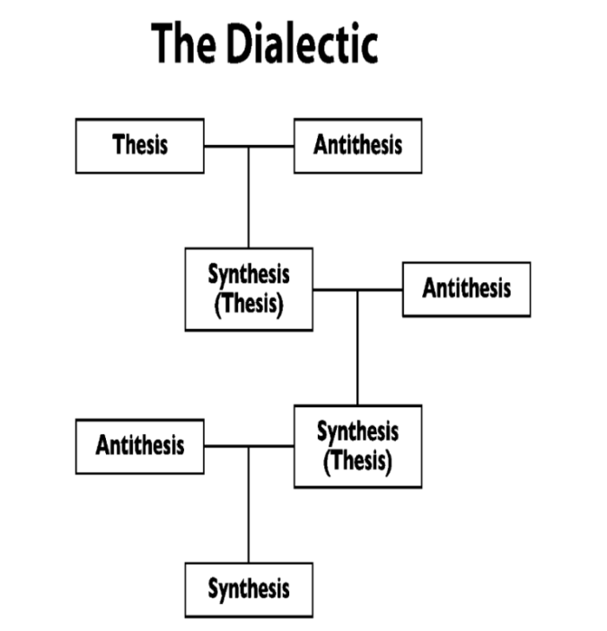
Dialectical method (logic)
A bit of Philosophy
“Dialectics” refers to a method of philosophical reasoning that examines contradictions between opposing viewpoints.
The core principle of dialectics is to analyze any given object or phenomenon from multiple angles by understanding its development and interrelationships.
To apply dialectic logic in team leadership, consider each situation through three key perspectives:
Multiple Points of View: Look at the situation from various perspectives to understand the current context.
Historical Context: Analyze the factors that led to the situation and predict potential future outcomes.
Interconnections: Evaluate the impact of the situation on other team members and ongoing processes.
Notes:
Dialectical logic is an upgrade of a formal logic – a cutting edge technology from an ancient times
[thIsis and antithIsis]
There are some additional interesting rules, but main takeaway is to analyze situation in many dimensions including time – how we get here, and what will be the consequences (results) in the future.
Even extremely good solution today, in long perspective could bring a terrible consequences, and it works and in reverse as well – not very good solution today may be the best one in long term.
It’s very important to understand for B track – there is now ideal solution, your main task is to understand consequences and to be able to work with them, to hold the direction to the strategic goals.

Slide 15
Dialectical method (logic) - Examples
A bit of Philosophy
Project Management: When leading a software development team, use dialectic logic to balance the need for rapid innovation (thesis) with the necessity of maintaining system stability (antithesis). Synthesize these opposing needs to find a middle ground that ensures both progressive development and reliable performance.
Conflict Resolution: If two team members have opposing ideas about how to implement a feature, encourage a dialectic approach by having them present their arguments and counterarguments. This process can lead to a synthesis of ideas, where a new, improved solution emerges that incorporates elements from both original proposals.
Resource Allocation: When deciding how to allocate limited resources like developer time or server capacity, consider the immediate needs of the project (thesis) as well as long-term growth objectives (antithesis). Using dialectic reasoning, develop a strategy that optimally supports both current and future demands.

Slide 16







So, you've just become a team lead of new team that will work on new project…
Team Leadership workshop: USE-cases
Dean - SM
Team:
Adam: A highly experienced senior developer, primarily focused on the technical aspects of projects.
Bob: A strong middle+ developer and has specific skills crucial to this project. Loyal to his former team and skeptical about the new team's potential.
Eva: A promising junior developer eager to learn and explore new technologies.
Diana: A tester with aspirations to advance in test automation. Expressed concerns about maintaining feature stability as new updates are implemented.
Mary: The product owner and business analyst, acting as the primary liaison between the team and the client.
Dean: A scrum master experienced in facilitating standard agile ceremonies but offers limited additional contributions.
Pavel: A DevOps engineer focused on achieving a fully automated CI/CD pipeline for the project.
Adam – SD
Mary – PO/BA
Bob – MD
Eva - JD
Diana - QA
Pavel - DevOps
You
Notes:
Takeaways are bold, good solution today may bring a very bad consequences tomorrow

Slide 17
You've just met your new team. What are your first actions to establish rapport and set expectations?
Team Leadership workshop: USE-cases
Case 1: Initial Team Engagement
Dean - SM
Adam – SD
Mary – PO/BA
Bob – MD
Eva - JD
Diana - QA
Hello team group!
Pavel - DevOps
You
Notes:
Start with individual one-on-one meetings to understand each team member’s expectations, strengths, and areas for growth. Follow up with a team meeting to outline project goals, roles, and responsibilities, fostering an open environment for questions and clarifications.
Basic rules and ceremonies
One on ones (gathering the information from previous slide)
Environment setting up (quality gates and pipelines)
Using of expertise
Creating a PDPs and Successors plans
Pair programming and KS sessions
RACI matrix
Team building is fine
R: Responsible. The person who is responsible for completing the task.
A: Accountable. The person who is accountable for the task. This person has the ultimate responsibility and authority.
C: Consulted. The person who is consulted before a decision or action is taken.
I: Informed. The person who is informed after a decision or action has been taken.

Slide 18
A client requires a specific framework, and another needs to be selected by your team. How will you facilitate this decision?
Team Leadership workshop: USE-cases
Case 2: Framework Decision-Making
Dean - SM
Adam – SD
Mary – PO/BA
Bob – MD
Eva - JD
Diana - QA
?
Pavel - DevOps
You
Notes:
Conduct a workshop where both the mandatory and optional frameworks are discussed. Allow team members, especially technical experts like Adam and Bob, to present their views and lead a structured discussion to reach a consensus.
Experience
Technologies support and popularity
Team desires
Your authority

Slide 19
The client asks for an estimation of the first epic comprised of several stories. Describe your approach and tools used for effective estimation.
Team Leadership workshop: USE-cases
Case 3.1: Epic Estimation Process
Dean - SM
Adam – SD
Mary – PO/BA
Bob – MD
Eva - JD
Diana - QA
?
Pavel - DevOps
You
Notes:
Use planning poker or another consensus-based estimation technique to involve all team members in the process. This ensures that different perspectives and expertise are considered, balancing out biases and leading to more accurate estimations.
Man hours or story points – what is the difference
Measure of complexity, which is individual for the team, and depends from SP definition – for example controller + simple service + db access class is good for the beginning, but you should change it when you’ll have an examples from current project
Don’t forget about well formulated definition of done – task isn’t finished until it isn’t deployed and tested
SMART

Slide 20
During the estimation session, Eva expresses confusion about the process, worried about her speed relative to Adam, it's obvious to her, that she'll work on the same task much longer. How will you address her concerns and ensure she understands the estimation process?
Team Leadership workshop: USE-cases
Case 3.2: Addressing Estimation Concerns
Dean - SM
Adam – SD
Mary – PO/BA
Bob – MD
Eva - JD
Diana - QA
?
Pavel - DevOps
You
Notes:
Offer additional training or a one-on-one session to explain the estimation process in detail to Eva. Emphasize that speed differences are expected and estimations often involve learning curves and adjustments.
From the very beginning you and your future team members are spiking on a different languages, same words have a different meaning for you, that’s why you should define and speak over and over again basic, obvious staff – you should teach your team to understand you and your style of explanation, and to give a possibility for team members try to explain such stuff, you’ll listen, learn more about your team, and will help to set up the communication
Plus – as soon you’ll find contradictions, as easy and fast you’ll go through storming phase

Slide 21
The Product Owner believes your team's estimation is too high. How will you handle this disagreement?
Team Leadership workshop: USE-cases
Case 3.3: Negotiating Estimates with the PO
Dean - SM
Adam – SD
Mary – PO/BA
Bob – MD
Eva - JD
Diana - QA
?
Pavel - DevOps
You
Notes:
Share the rationale behind each estimate with Mary, including the complexity and risks involved. Consider revising the estimates if new information is provided, or propose a reevaluation after an initial phase of the project to validate assumptions.
RACI and zones of responsibility should be defined from the start
Mail that it won’t work but you and your team will do their best

Slide 22
Rising tension between Adam and Bob is affecting team dynamics. How will you intervene and address the underlying issues?
Team Leadership workshop: USE-cases
Case 4: Conflict Resolution Among Team Members
Dean - SM
Adam – SD
Mary – PO/BA
Bob – MD
Eva - JD
Diana - QA
?
Pavel - DevOps
You
Notes:
Initiate a mediation session where Adam and Bob can express their concerns in a controlled environment. Facilitate a discussion to understand their perspectives, and guide them towards a professional understanding or compromise.
Successors plan

Slide 23
Diana reports recurrent issues with features breaking after updates. What strategies will you implement to tackle this?
Team Leadership workshop: USE-cases
Case 5.1: Quality Assurance Adaptations
Dean - SM
Adam – SD
Mary – PO/BA
Bob – MD
Eva - JD
Diana - QA
?
Pavel - DevOps
You
Notes:
Implement a more robust regression testing strategy. Encourage Diana's growth in automation testing by integrating automated regression tests, which helps catch breaking changes earlier.
RACI and zones of responsibility should be defined from the start
Quality Gates
Root Cause investigation
Definition of done

Slide 24
Despite agreed-upon quality measures, Bob disregards these guidelines, influencing Eva to follow suit. How will you realign their actions with team protocols?
Team Leadership workshop: USE-cases
Case 5.2: Guideline Compliance and Role Modeling
Dean - SM
Adam – SD
Mary – PO/BA
Bob – MD
Eva - JD
Diana - QA
?
Pavel - DevOps
You
Notes:
Address Bob's non-compliance in a one-on-one meeting, emphasizing team standards and the influence of his actions. Reinforce the importance of adhering to team decisions through regular reminders and by setting clear expectations.

Slide 25
Bob is overwhelmed and becoming a bottleneck. What steps will you take to distribute the workload more effectively?
Team Leadership workshop: USE-cases
Case 6.1: Managing Capacity and Bottlenecks
Dean - SM
Adam – SD
Mary – PO/BA
Bob – MD
Eva - JD
Diana - QA
?
Pavel - DevOps
You
Notes:
Analyze the workload distribution and identify tasks that can be reallocated from Bob to other team members like Eva and Pavel, who may benefit from the learning opportunity. This helps in skill building and reduces the single-point dependency on Bob.

Slide 26
Bob suffers an injury, sidelining him for 3 weeks. How will your team manage in his absence initially, and what long-term strategies will you consider?
Team Leadership workshop: USE-cases
Case 6.2: Handling Unexpected Absences
Dean - SM
Adam – SD
Mary – PO/BA
Bob – MD
Eva - JD
Diana - QA
?
Pavel - DevOps
You
Notes:
If Bob’s absence was unforeseen and no backup plan was in place, quickly identify team members who can temporarily take over his responsibilities. For future, develop a knowledge-sharing plan that includes regular documentation and cross-training sessions to mitigate such risks.

Slide 27
The client demands the incorporation of a high-priority task mid-sprint, causing disagreement among team members. How do you assess and communicate your decision?
Team Leadership workshop: USE-cases
Case 7: Sprint Interruption by Client Request
Dean - SM
Adam – SD
Mary – PO/BA
Bob – MD
Eva - JD
Diana - QA
?
Pavel - DevOps
You
Notes:
Assess the urgency and impact of the request. Propose an alternative approach to include the task in the next sprint to maintain the current sprint's focus and commitments. Negotiate with Mary to balance client demands with sustainable development practices.

Slide 28
User story contains several tasks, one of which has tiny functionality but at the same time require large efforts. How will you communicate it with PO / customer?
Team Leadership workshop: USE-cases
Case 8: Effort vs. Impact Communication
Dean - SM
Adam – SD
Mary – PO/BA
Bob – MD
Eva - JD
Diana - QA
?
Pavel - DevOps
You
Notes:
Clearly explain the resource-intensity of the tasks to Mary and the client, providing a detailed breakdown of the efforts required. Offer alternatives that achieve similar goals with possibly lower effort if practical.
Sometimes only you is the one who could provide information about effort measure

Slide 29
Business Analyst creates contradiction requirements unclear for developers. What will be your actions?
Team Leadership workshop: USE-cases
Case 9: Unclear requirements
Dean - SM
Adam – SD
Mary – PO/BA
Bob – MD
Eva - JD
Diana - QA
?
Pavel - DevOps
You
Notes:
Organize a requirement clarification session with the BA and all relevant stakeholders. Use visual aids like flowcharts or diagrams to map out requirements and resolve discrepancies practically and visually.
Idea is to provide a situation when you need to change a style of working of team member not from your technical pool

Slide 30
A team member expresses interest in becoming a team lead. How will you mentor and prepare them for leadership responsibilities?
Team Leadership workshop: USE-cases
Case 10: Aspiring Team Leader Development
Dean - SM
Adam – SD
Mary – PO/BA
Bob – MD
Eva - JD
Diana - QA
?
Pavel - DevOps
You
Notes:
Provide the aspiring leader with opportunities to lead small initiatives, offering guidance and constructive feedback. Gradually increase their responsibilities and include them in leadership meetings to gain experience.

Slide 31
Minutes before a crucial demo to the client, a key feature fails. What immediate actions do you take to salvage the presentation?
Team Leadership workshop: USE-cases
Case 11: Pre-Demo Crisis Management
Dean - SM
Adam – SD
Mary – PO/BA
Bob – MD
Eva - JD
Diana - QA
?
Pavel - DevOps
You
Notes:
Quickly troubleshoot the issue with the help of the development team, especially key technical members like Adam or Pavel. If a fix is not feasible, prepare to demonstrate an alternative part of the application or use a well-prepared mockup.

Slide 32
With the project nearing completion and high team morale. What steps do you take to ensure a smooth transition or redeployment for team members?
Team Leadership workshop: USE-cases
Case 12: The End
Dean - SM
Adam – SD
Mary – PO/BA
Bob – MD
Eva - JD
Diana - QA
?
Pavel - DevOps
You
Notes:
Discuss future opportunities with the team, seeking feedback on their next preferred roles or projects. Facilitate transition plans that align with their career goals and maintain team morale by celebrating the project’s success and acknowledging individual contributions.

Slide 33

Homework
Write your own solution for each case, try to think about consequences of your own decisions

Slide 34
Q&A
Feel free to write them in the chat

Slide 35
Feedback and takeaways
Help the program to become better
Notes:
I’ll be very grateful for detailed feedback to understand what worked well and what can be improved in future runs.
Sent badges to course creators and speakers, and express your opinion about course, session and your takeaways in the chat – it takes 1 minute for you but gives a good motivation for us for a long time!

Slide 36
Thank you!
Please contact us
uladzimir_litvinau@epam.com
wl.litvinov@gmail.com

